Slide 1


How to really use Zoom AI Companion Part 1
Notes:
https://copilot.cloud.microsoft/en-US/copilot-word

Slide 2

“I joined a Zoom meeting in my pajamas and no one even noticed. It’s like my dream come true!”

Slide 3



Notes:
https://www.youtube.com/channel/UC35ZpwldGw7ZJ5R-2sLijzw

Slide 4
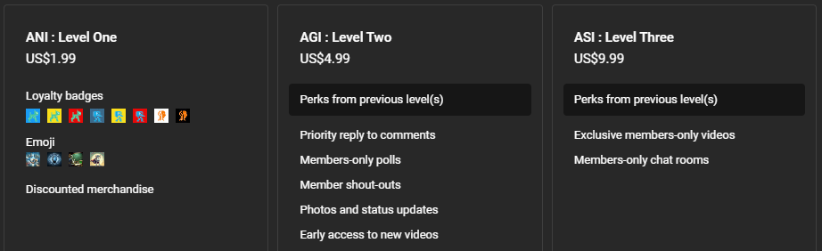

Membership has its privileges
Notes:
https://www.youtube.com/channel/UC35ZpwldGw7ZJ5R-2sLijzw/join

Slide 5

Getting Zoom AI Companion

Slide 6
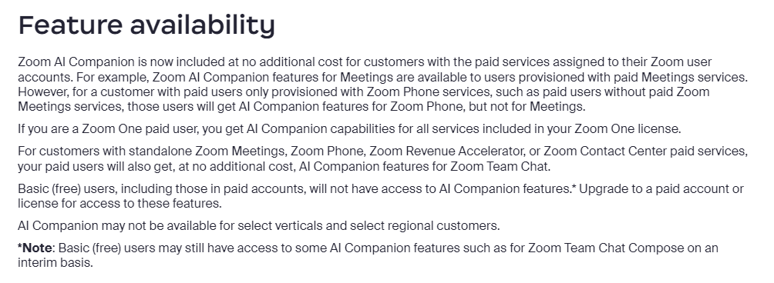
Notes:
https://support.zoom.com/hc/en/article?id=zm_kb&sysparm_article=KB0057623

Slide 7

Notes:
https://support.zoom.com/hc/en/article?id=zm_kb&sysparm_article=KB0057623

Slide 8

Turning On Zoom AI Companion

Slide 9
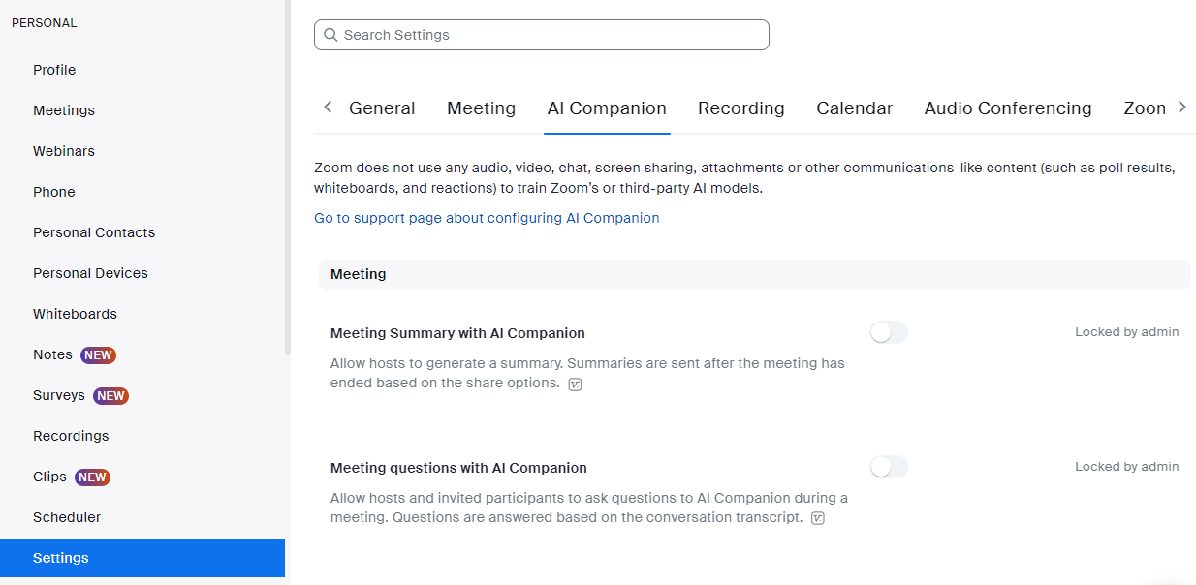
The user Settings Trap
Notes:
https://zoom.us/profile/setting

Slide 10
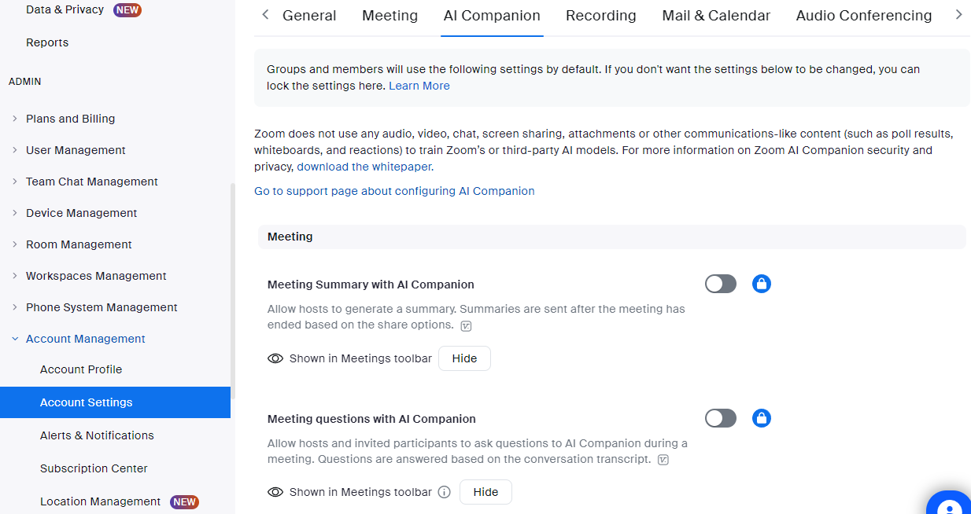
Use account settings
Notes:
https://zoom.us/account/setting

Slide 11


Slide 12
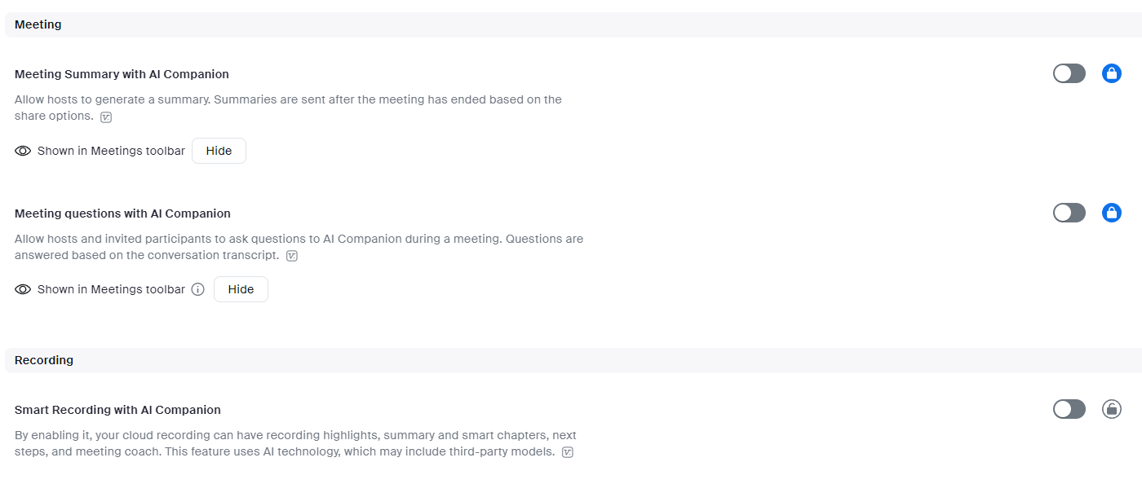
Demo: Turning ON AI Companion

Slide 13


